Slide 1
Design Sketch + Concept
ISCG7427 – Agile and lean software Development
AGILE TECHIES

Slide 2
Flow Chart
SPLASH SCREEN
LOGIN
RESET
PASSWORD
DASHBOARD (MENU)
REGISTER
ENROLL
AT UNITEC
CALENDAR
FORUM
TIPS TO SUCCESS
NOTES
SETTINGS
LOGOUT

Slide 3
Splash screen
Simple page which give the app some load time.
Few seconds of loading before opening the login page.
Doesn’t have much for the user to interact with at this stage.

Slide 4
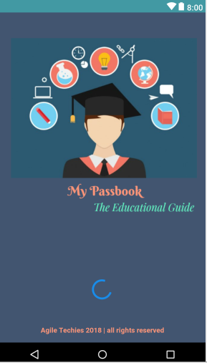
Splash Screen - Prototype
Contains:
Logo of the application
Name of the application
Animated progress bar
Copyright and rights reserved
NOTE: The logo and the name is just so you can understand the design better. We will talk and decide on that on a later date.

Slide 5
Login
As soon as the user logs in to the application with their username and password the dashboard page will open.
Now, if the user of the app is not yet a registered student they would have the option to register to this application .
Also, the user will have the option to reset their password that is if they have forgotten their password.

Slide 6
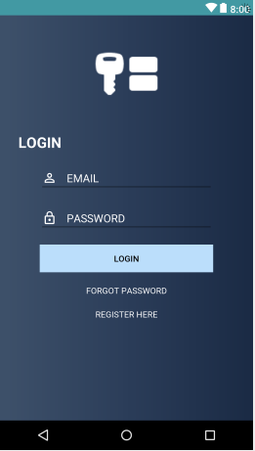
Login - Prototype
Contains:
The login image
Email Address input
Password input
Login Button
Forgot password button
Register here button

Slide 7
Register
This is for anyone who wants to register to use this application.
This basically asks for a few details from you so that you can use this application to the max.

Slide 8
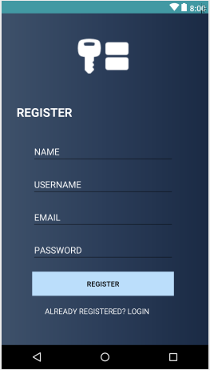
Register - Prototype
Contains:
User’s personal name input
Username input
Email address input
Password input
Button to register
Button to go back to the login page if you already have an account.

Slide 9
Reset Password
Simple FORGOT PASSWORD screen will show up asking the users to give their relevant email address which will take them to the password reset instructions.
The user also has an option to go back to the login page had they remembered their password.

Slide 10
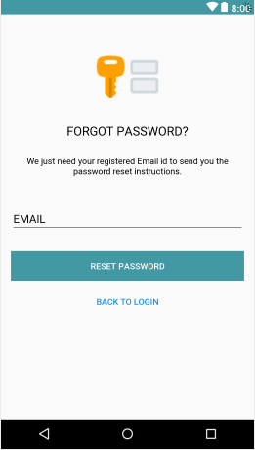
Reset Password - Prototype
Contains:
Login Image
Email address input
Button to reset their password
Back to login button

Slide 11
Dashboard
Once the user is logged in the Dashboard (menu) will be open for users to select from.
User can then select one of the four buttons to go to the particular page they have clicked on.
There are six options to choose from in the main menu.

Slide 12
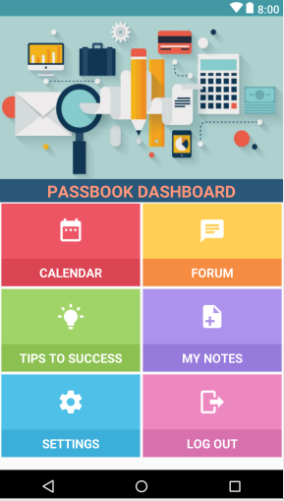
Dashboard - Prototype
Contains:
Calendar
Forum
Settings
Tips to success
Notes
Logout

Slide 13
Calendar

Slide 14
Calendar - Prototype

Slide 15
Forum
User can add in quires from any topic which other will be able to answer or help out with.
They can add images also if they require.
Anyone who has knowledge on the particular topic can answer questions.

Slide 16
Forum - Prototype

Slide 17
Tips to success
There is no user input in this particular one activity.
When user clicks on this screen the user gets tips on specific topics:
Studying Tips
Career Preparation
Setting Goals

Slide 18
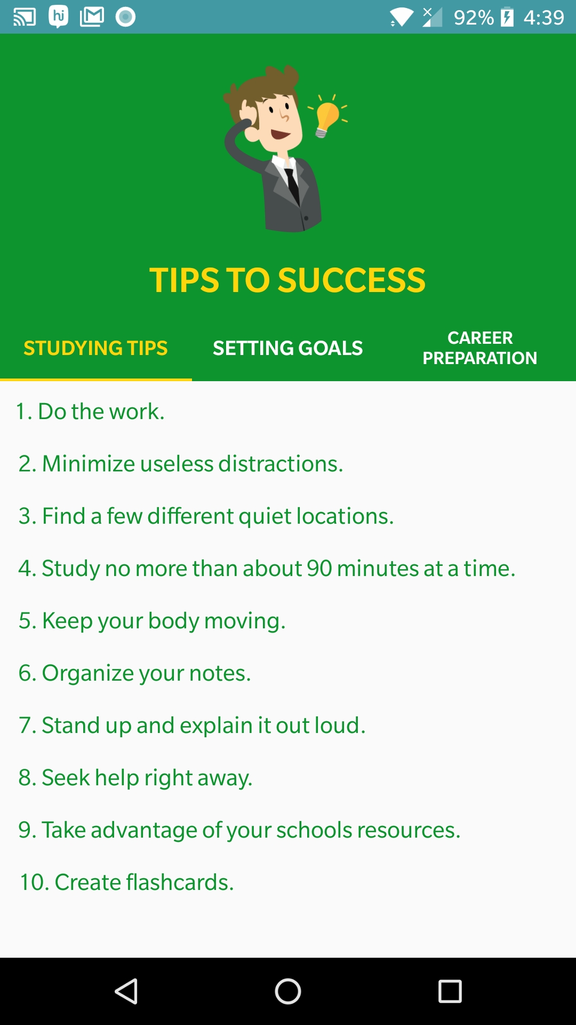
Tips to success - Prototype
When the user initially clicks on Tips to success, it will
automatically open up “studying tip” tab with bullet point of tips.
Each tab has up to 10 bullet points.

Slide 19
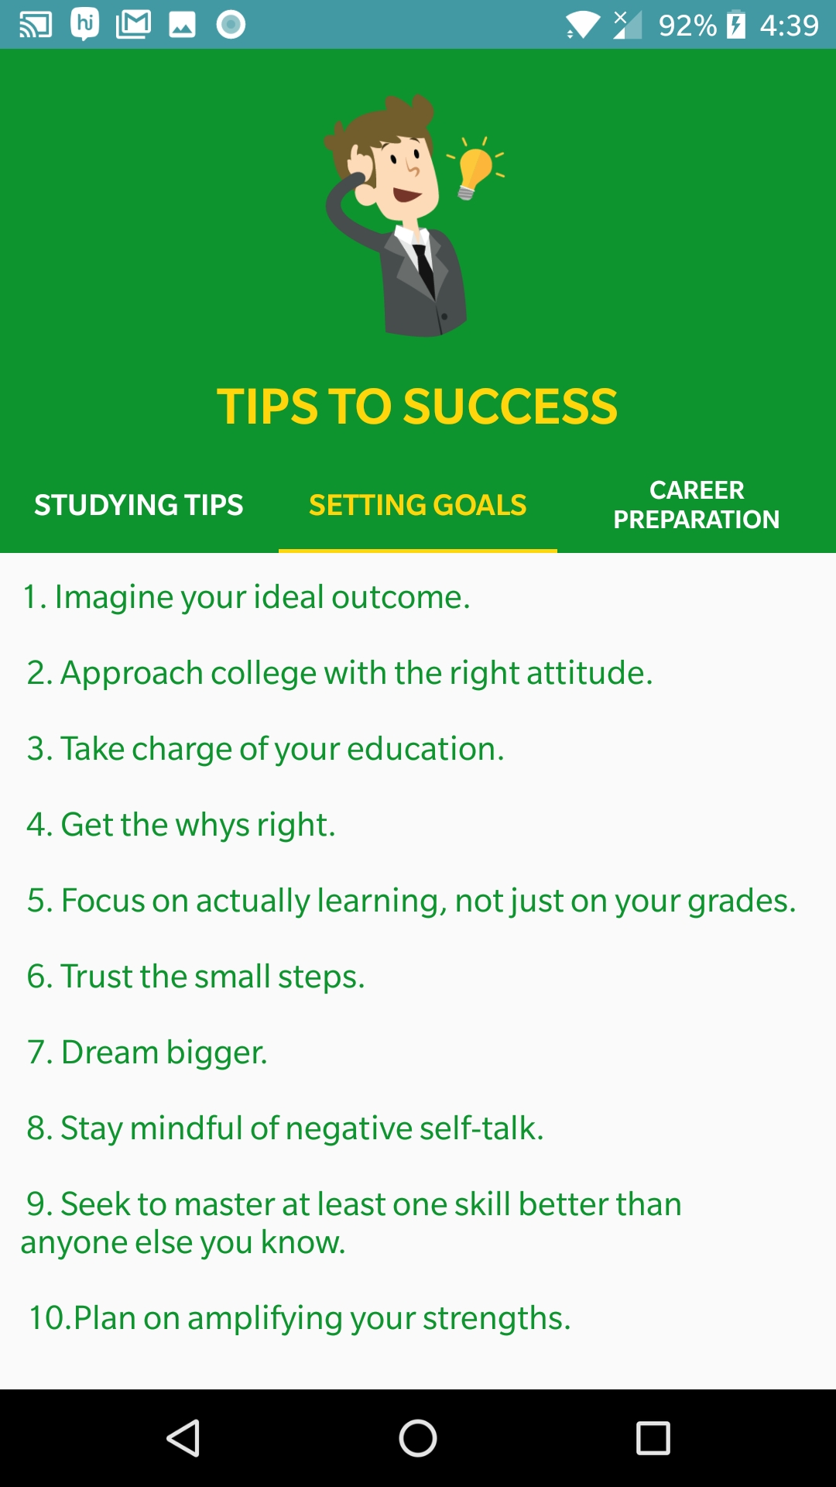
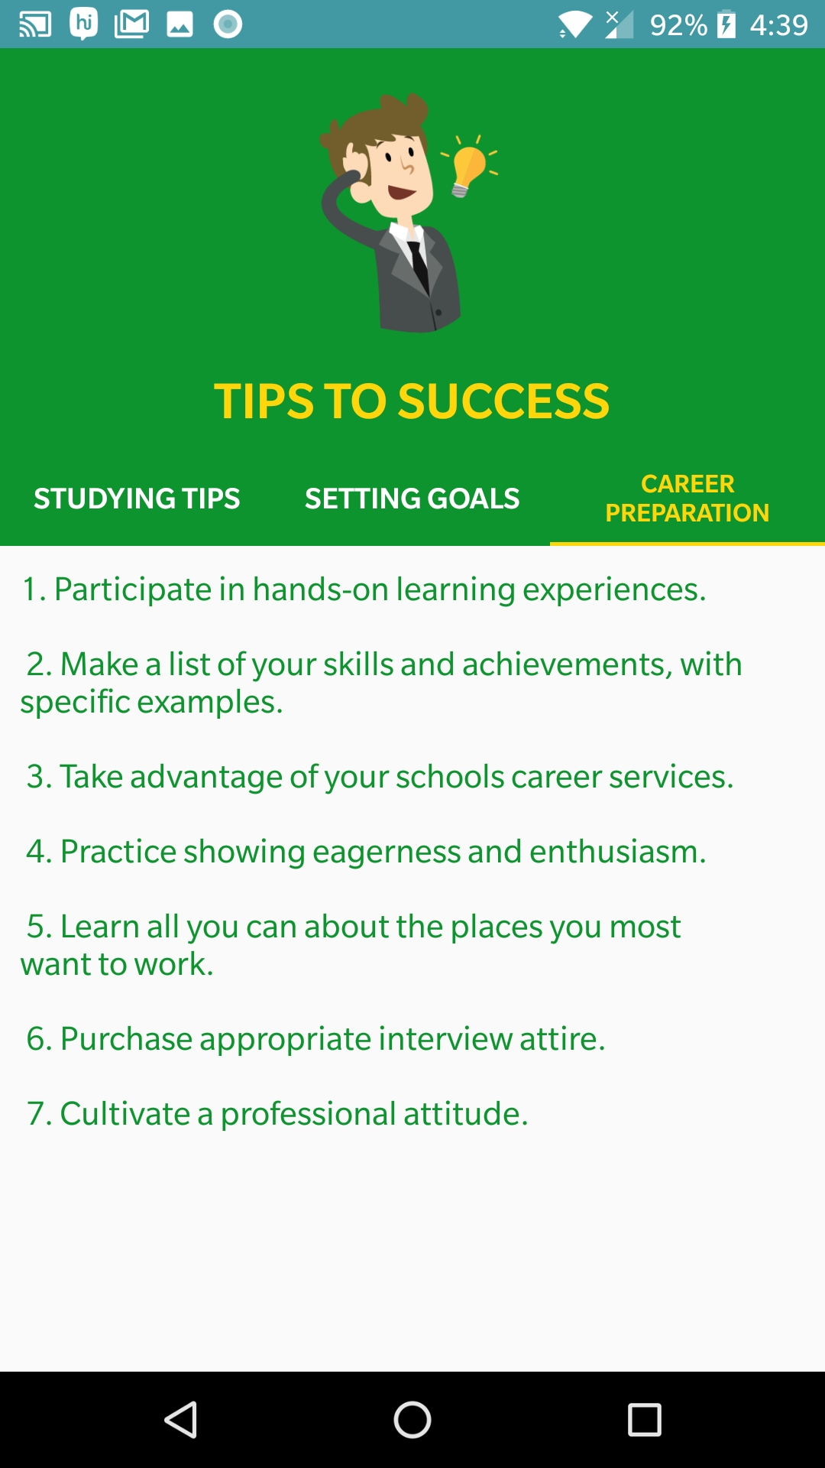
Tips to success - Prototype

Slide 20
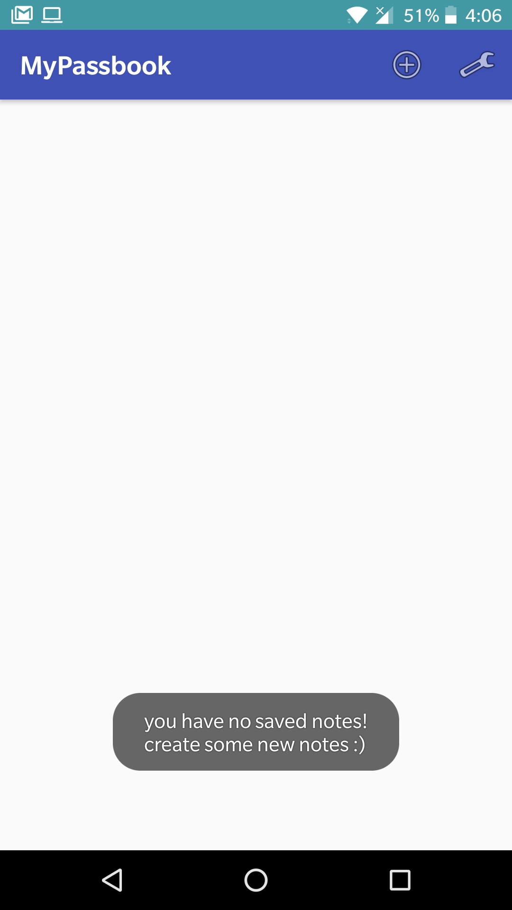
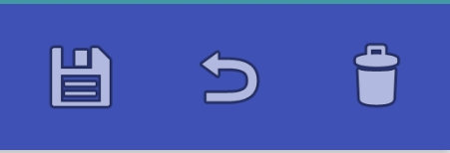
Notes
As soon as the user clicks on the notes button they will be directed to the notes screen.
Where the user has the option to add, edit and delete their notes as they want.
This is a very simple design.
Toolbar contains:
Add
Settings
Save
Delete
Undo

Slide 21
Notes - Prototype
When the user initially clicks the “notes” on the dashboard screen this message will pop up and the screen will be empty.
The user can add in notes by clicking on the PLUS sign on the top banner in the right.

Slide 22
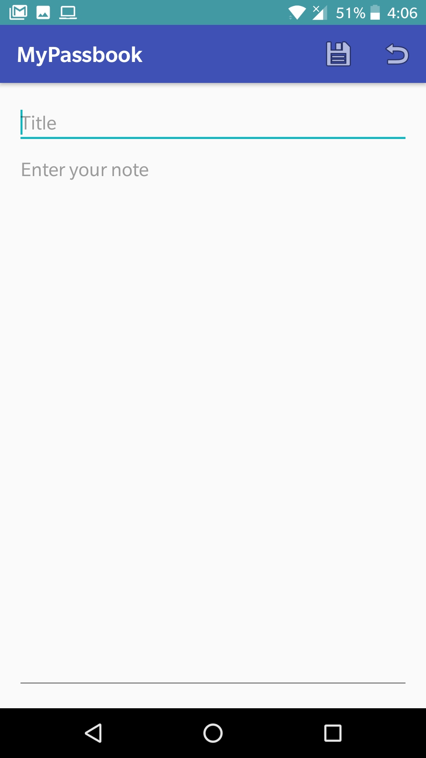
Notes - Prototype
Once the user clicks on the plus sign this screen will open up telling the user to write in the topic/title and the note he wants to add in here.
The user can’t save any notes without the title or the content.
The user has two options in this page ones they type in the notes.
Save the item
Go back without saving

Slide 23
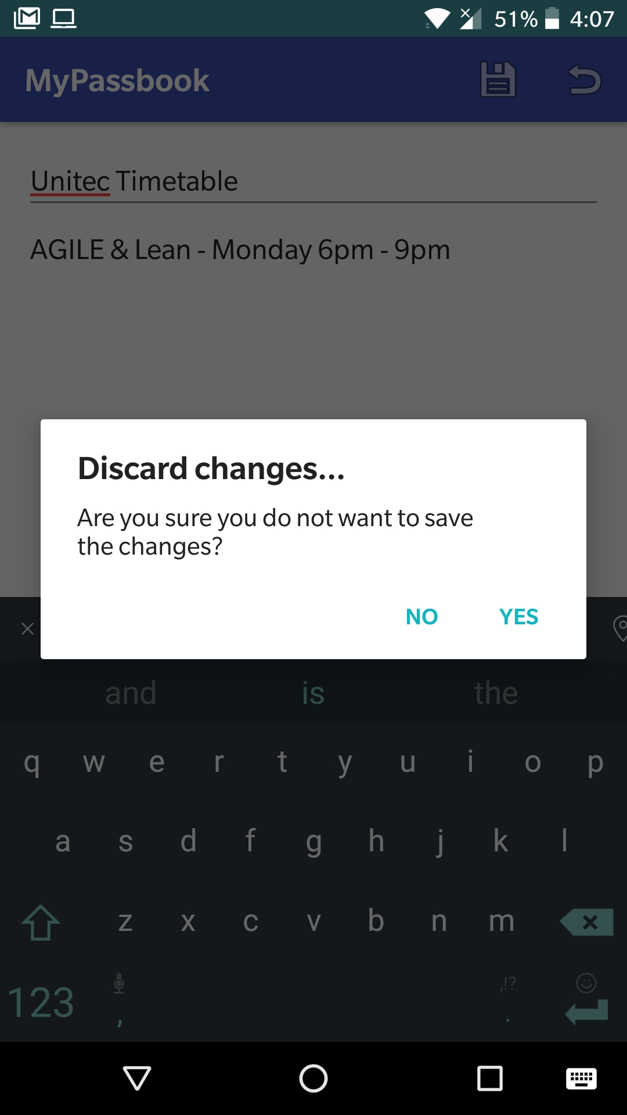
Notes - Prototype
If the user starts typing content and presses the arrow button the user will get a prompt asking “are you sure you do not want to save the changes.”
This message only comes up if the user has already typed out a few information.
If the user hasn’t typed out anything the screen will go back to the first screen.

Slide 24
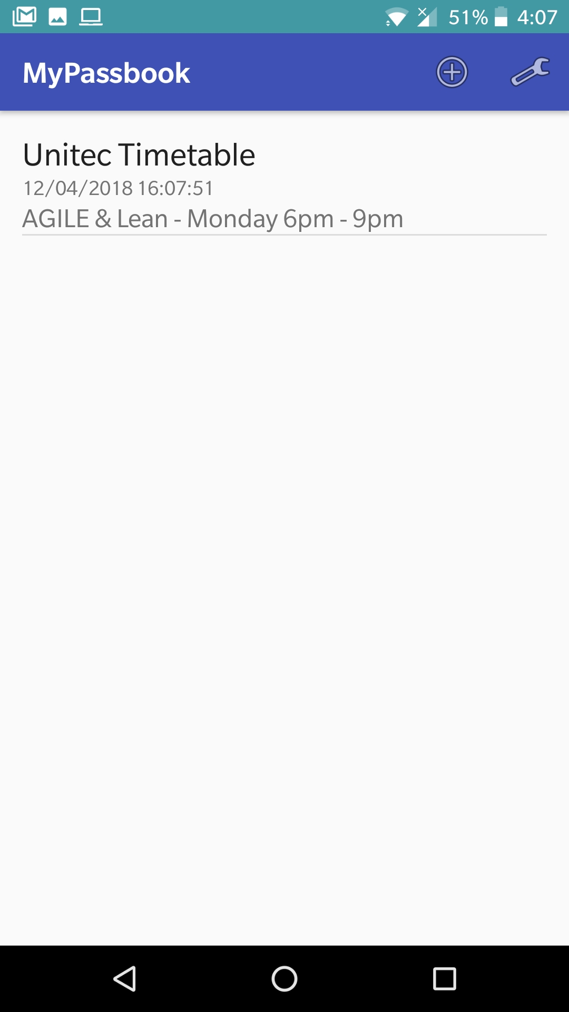
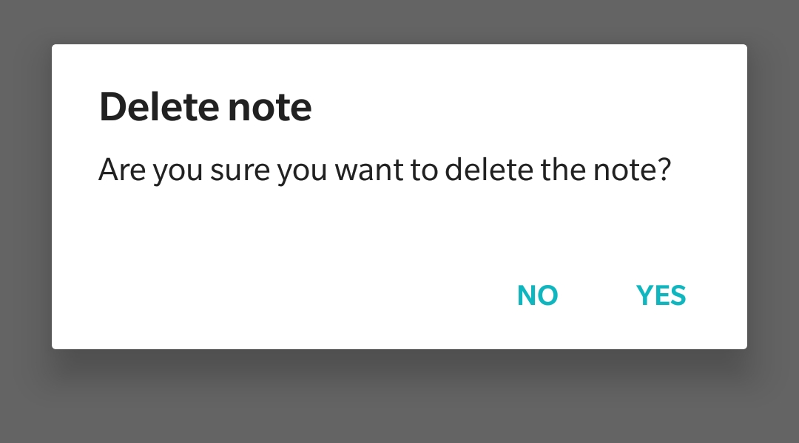
Notes – Prototype
When the user saves information the screen will display the information like this.
Each note the user adds the list will display all.
User can edit, delete each one if need be, the user can click on the note and edit information and if the user wants to delete there will be a “bin” button on the top banner to delete. (again there will be a prompt; asking if they are sure they want to delete this note?” shown below:

Slide 25
Settings

Slide 26
Settings - Prototype

Slide 27
Logout
When the user clicks logout the screen will take them back to login page.
That’s all this button does.

